Slide 1
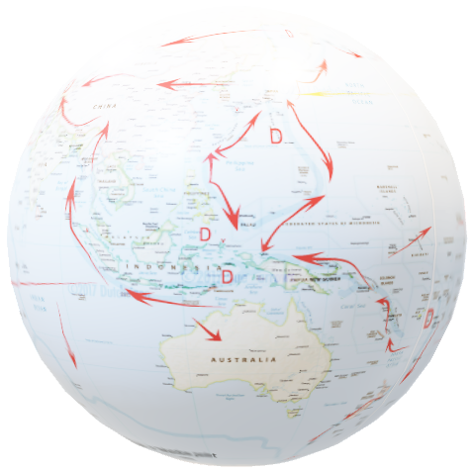
TerriaJS - An open-source framework for
web-based geospatial catalogue explorers
NATIONAL MAP
“TerriaJS was born late 2014 thanks to NationalMap. It started as a web based platform. The Australian NationalMap platform contributed greatly in opening data by government agencies and in discovering and consuming open data by general public, industry, academia and the government itself. NationalMap is managed and maintained by: Digital Transformation Agency - product ownership, Geoscience Australia - product hosting, Data61 Terria - product software development.”^{[Ref]}
This demonstrates the use of GSKY from NCI, and is primarily for developers, but is also a user guide. See the Word document for detailed process flow.
Will take approximately 5 minutes to watch this animation.
Open the *.pptx for controlled slideshow at your pace.
DISCLAIMER
Though relevant code snippets from both TerriaMap and GSKY(‘ows.go’) are shown to describe the steps, not every step is detailed like that. The codes shown will give pointers to understand the programs. More details are given in the Word document, but it too is not a tutorial to learn these extremely complex programs.
The slide show will begin in 5 seconds !

Slide 3
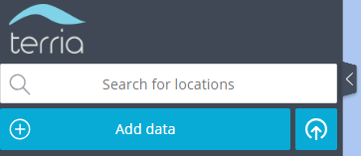
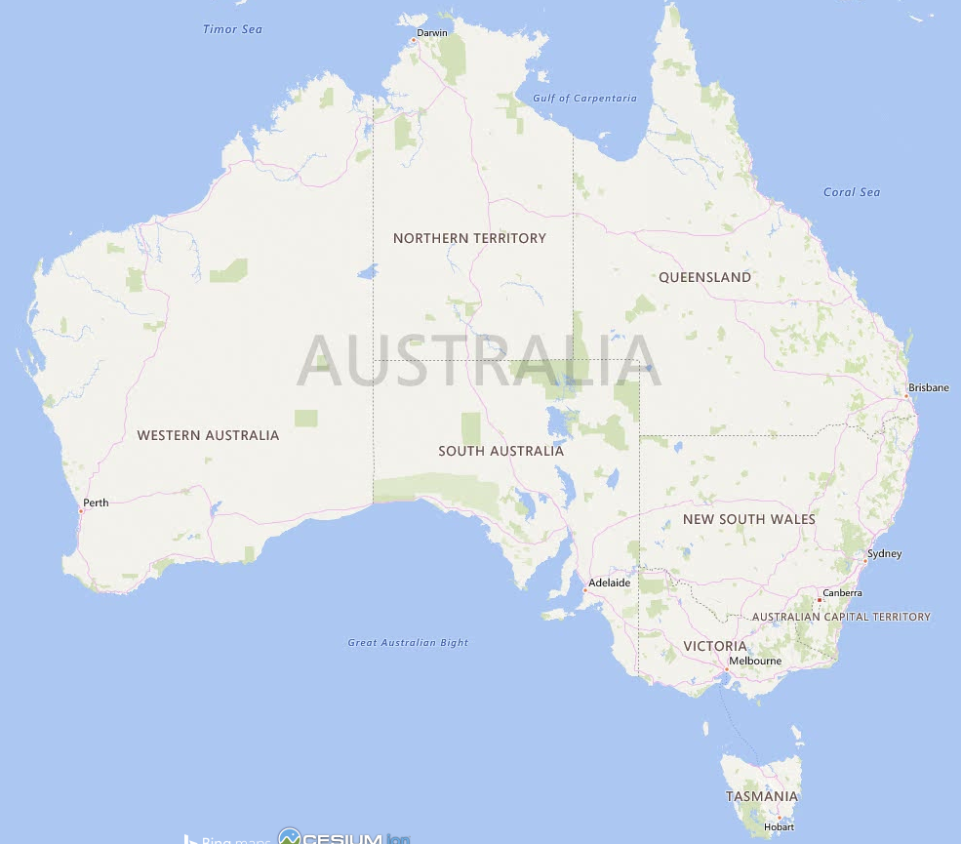


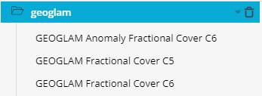

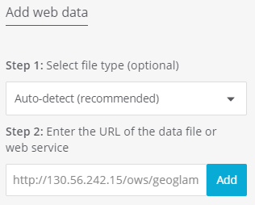

GEOGLAM – An implementation via GSKY in TerriaJS
Geo-spatial data stored in GSKY database can be layered over a world map. Steps and code snippets to show the usage and inner workings.
Next Slide
/TerriaMap/build/TerriaJS/build/TerriaJS-specs.js:44667:
return cleanUrl(this.url) + '?service=WMS&version=1.3.0&request=GetCapabilities';
http://130.56.242.15/ows/geoglam?service=WMS&request=GetCapabilities&version=1.3.0&tiled=true
gopath/src/github.com/nci/gsky/ows.go:179: case GetCapabilities:
utils.ExecuteWriteTemplateFile(w, conf, utils.DataDir+"/templates/WMS_GetCapabilities.tpl")
/TerriaMap/build/TerriaJS/build/TerriaJS-specs.js:44818:
layerTitles: {
get: function get() {
return this._allLayersInRawMetadata.map(function (layer) {
return layer.Title || layer.Name;
});
}
}

Slide 4
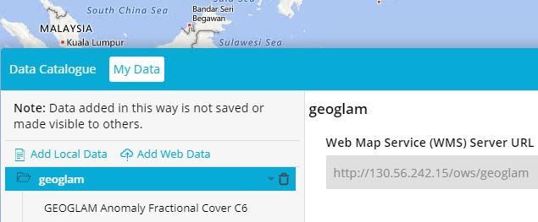
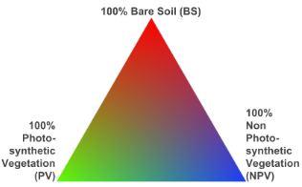
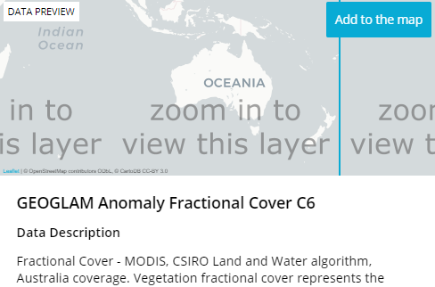
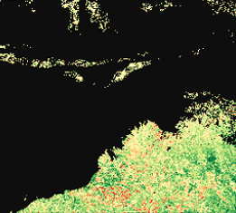
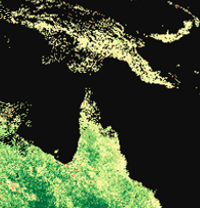
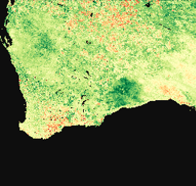
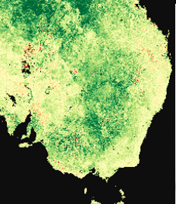

GEOGLAM – An implementation via GSKY in TerriaJS
TerriaJS is a Node.JS implementation of a webserver that can connect to various data sources that comply with WMS formats. It can send requests to GSKY and display the returned results. This slide will show an overview of the process flow. Code snippets from both TerriaJS and GSKY are shown.
/TerriaMap/build/TerriaJS/build/TerriaJS-specs.js:45977:
legendUri = new URI(cleanUrl(catalogItem.url) + '?service=WMS&version=1.1.0&request=GetLegendGraphic&format=image/png&transparent=True&layer=' + encodeURIComponent(thisLayer.Name));
http://130.56.242.15/ows/geoglam?service=WMS&version=1.1.0&request=GetLegendGraphic&format=image%2Fpng&transparent=True&layer=global%3Ac6%3Amonthly_anom_frac_cover&srs=EPSG%3A3857
/TerriaMap/build/TerriaJS/build/TerriaJS-specs.js:45449:
return new WebMapServiceImageryProvider({
url: cleanAndProxyUrl(this, this.url),
layers: this.layers,
getFeatureInfoFormats: this.getFeatureInfoFormats,
parameters: parameters,
getFeatureInfoParameters: parameters,
tilingScheme: defined(this.tilingScheme) ? this.tilingScheme : new WebMercatorTilingScheme(),
maximumLevel: maximumLevel
});
/TerriaMap/build/TerriaJS/build/TerriaJS-specs.js:45298:
var describeLayersURL = cleanUrl(that.url) + '?service=WMS&version=1.1.1&sld_version=1.1.0&request=DescribeLayer&layers=' + encodeURIComponent(that.layers);
http://130.56.242.15/ows/geoglam?time=2001-01-01T00%3A00%3A00.000Z&srs=EPSG%3A3857&transparent=true&format=image%2Fpng&exceptions=application%2Fvnd.ogc.se_xml&styles=&tiled=true&feature_count=101&service=WMS&version=1.1.1&request=GetMap&layers=global%3Ac6%3Amonthly_anom_frac_cover&bbox=15028131.257091936%2C-5009377.085697312%2C17532819.79994059%2C-2504688.542848654&width=256&height=256
http://130.56.242.15/ows/geoglam?time=2001-01-01T00%3A00%3A00.000Z&srs=EPSG%3A3857&transparent=true&format=image%2Fpng&exceptions=application%2Fvnd.ogc.se_xml&styles=&tiled=true&feature_count=101&service=WMS&version=1.1.1&request=GetMap&layers=global%3Ac6%3Amonthly_anom_frac_cover&bbox=15028131.257091936%2C-2504688.542848654%2C17532819.79994059%2C0&width=256&height=256
http://130.56.242.15/ows/geoglam?time=2001-01-01T00%3A00%3A00.000Z&srs=EPSG%3A3857&transparent=true&format=image%2Fpng&exceptions=application%2Fvnd.ogc.se_xml&styles=&tiled=true&feature_count=101&service=WMS&version=1.1.1&request=GetMap&layers=global%3Ac6%3Amonthly_anom_frac_cover&bbox=12523442.714243278%2C-2504688.542848654%2C15028131.257091936%2C0&width=256&height=256
http://130.56.242.15/ows/geoglam?service=WMS&version=1.1.1&sld_version=1.1.0&request=DescribeLayer&layers=global%3Ac6%3Amonthly_anom_frac_cover
http://130.56.242.15/ows/geoglam?time=2001-01-01T00%3A00%3A00.000Z&srs=EPSG%3A3857&transparent=true&format=image%2Fpng&exceptions=application%2Fvnd.ogc.se_xml&styles=&tiled=true&feature_count=101&service=WMS&version=1.1.1&request=GetMap&layers=global%3Ac6%3Amonthly_anom_frac_cover&bbox=15028131.257091936%2C-5009377.085697312%2C17532819.79994059%2C-2504688.542848654&width=256&height=256
gopath/src/github.com/nci/gsky/ows.go:206:
case DescribeLayer:
utils.ExecuteWriteTemplateFile(w, conf.Layers[idx], utils.DataDir+"/templates/WMS_DescribeLayer.tpl")
gopath/src/github.com/nci/gsky/ows.go:220::
case GetMap:
proc.InitTilePipeline(ctx, conf.ServiceConfig.MASAddress, conf.ServiceConfig.WorkerNodes, conf.Layers[idx].MaxGrpcRecvMsgSize, conf.Layers[idx].WmsPolygonShardConcLimit, conf.ServiceConfig.MaxGrpcBufferSize, errChan)
out, err := utils.EncodePNG(norm, styleLayer.Palette)
w.Write(out)
Next Slide

Slide 5
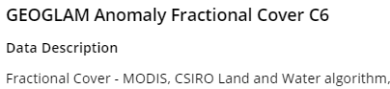
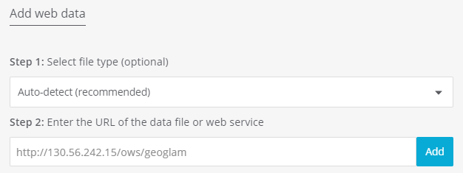
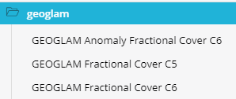
GEOGLAM – An implementation via GSKY in TerriaJS
http://130.56.242.15/ows/geoglam?service=WMS&version=1.1.1&sld_version=1.1.0&request=DescribeLayer&layers=global%3Ac6%3Amonthly_anom_frac_cover DescribeLayer:
utils.ExecuteWriteTemplateFile(w, conf.Layers[idx], utils.DataDir+"/templates/WMS_DescribeLayer.tpl")
Geo-spatial data stored in GSKY database can be layered over a world map. Steps and code snippets to show the usage and inner workings.
http://130.56.242.15/ows/geoglam?service=WMS&request=GetCapabilities&version=1.3.0&tiled=true
GetCapabilities:
utils.ExecuteWriteTemplateFile(w, conf, utils.DataDir+"/templates/WMS_GetCapabilities.tpl")
Next Slide

